Slide 1
Grants.gov
Life Cycle Training
Office of Sponsored Research

Slide 2
What is Grants.gov?
Web application that publishes funding opportunities from federal government agencies such as NIH, DOD, NSF, DOE, etc.
Single access point for over 900 grant programs offered by 26 Federal granting agencies.
A portal called Workspace to flow through grant applications to other sponsoring agencies such as NIH, DOD, NSF, DOE, etc. Workspace is a system-to-system submitting portal similar to Cayuse.

Slide 3
What is Grants.gov Workspace?
Grants.gov Workspace is beginning to replace Federal agency specific proposal submission systems.
DoD: some solicitations/RFP language instructs only to use Grants.gov to submit.
NSF: is beginning to put language in their solicitations for certain programs to submit only through Grants.gov.

Slide 4
What does Grants.gov Workspace do?
For agencies that use the SF424 application mechanism, it mirrors the SF424.
For other agencies that use their own application format, it mirrors that agency’s application format.
It validates the proposal for content only, meaning it checks to see that all required fields have information inserted.
Lesson Learned: Workspace does not validate agency specific guidelines such as page limits, file names, etc.

Slide 5
What does Grants.gov Workspace do?
If there are outside collaborators Workspace allows access to the application so they can complete their piece.
The individual forms can be either completed online or downloaded individually and then uploaded into Workspace when completed.
Contains an activity log in the proposal for ease in telling when and who completed actions.

Slide 6
How to get started?
Any one working on the proposal such as the administrator, PI or collaborator is a “Participant.”
Participants need to have a profile setup in Grants.gov.
UNC participants need their profile affiliated with UNC.

Slide 7
How to get started?
Some participants may already have a profile but may be unaffiliated. They must create a new profile to affiliate.
After participant’s profile is affiliated their user role needs to be assigned by a manager in OSR. Role is workspace manager.
Lesson Learned: If the Participant is not affiliated with UNC, SPS will not be able to see or submit the proposal

Slide 8
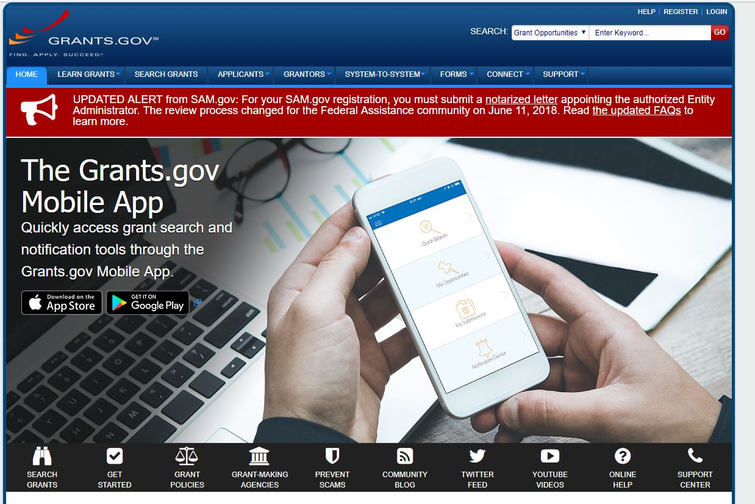

Slide 9
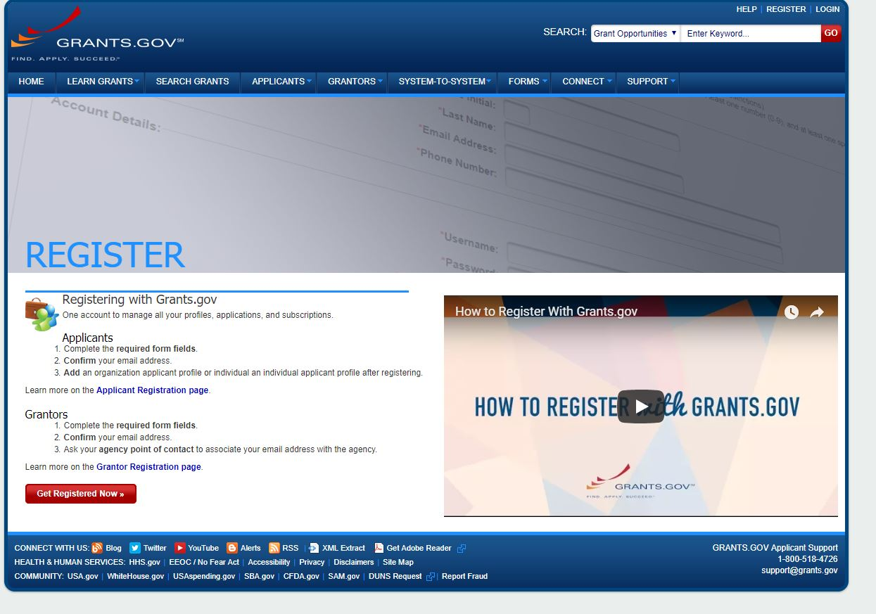

Slide 10
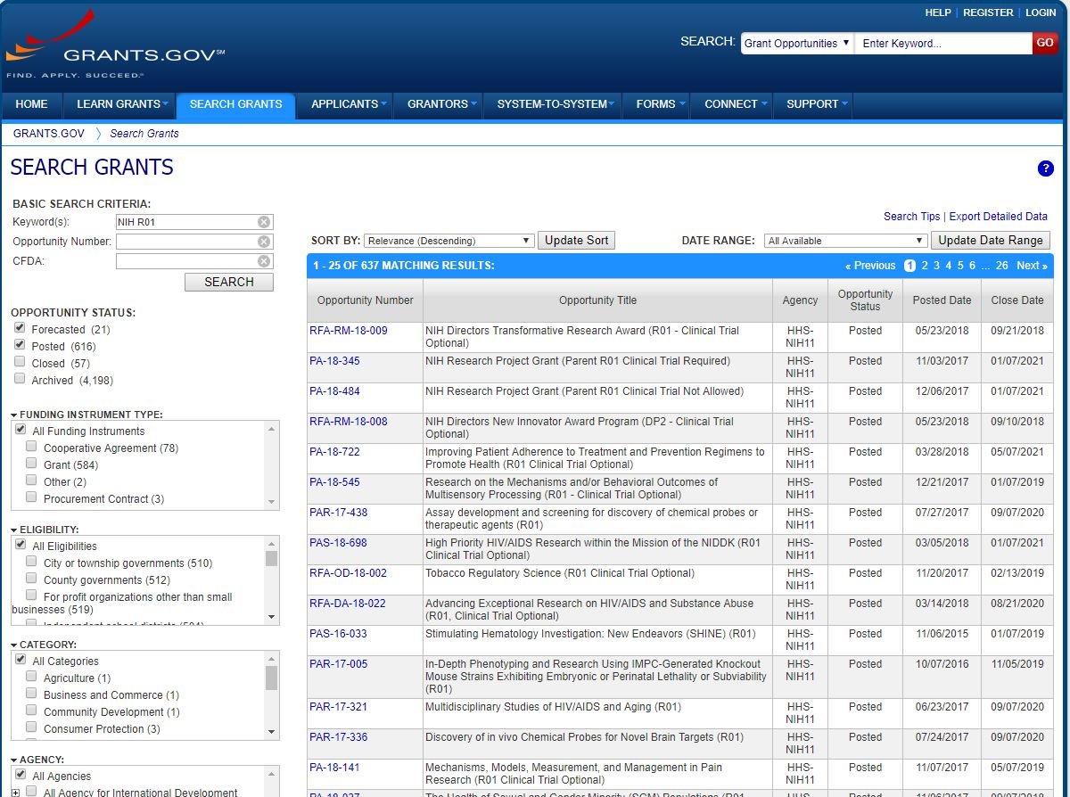
Creating a Workspace (Proposal): 1
Go to “Search Grants” on top menu bar

Slide 11
Creating a Workspace (Proposal): 2
Type keywords or opportunity number

Slide 12
Creating a Workspace (Proposal): 3
When you found your opportunity number, click on it

Slide 13
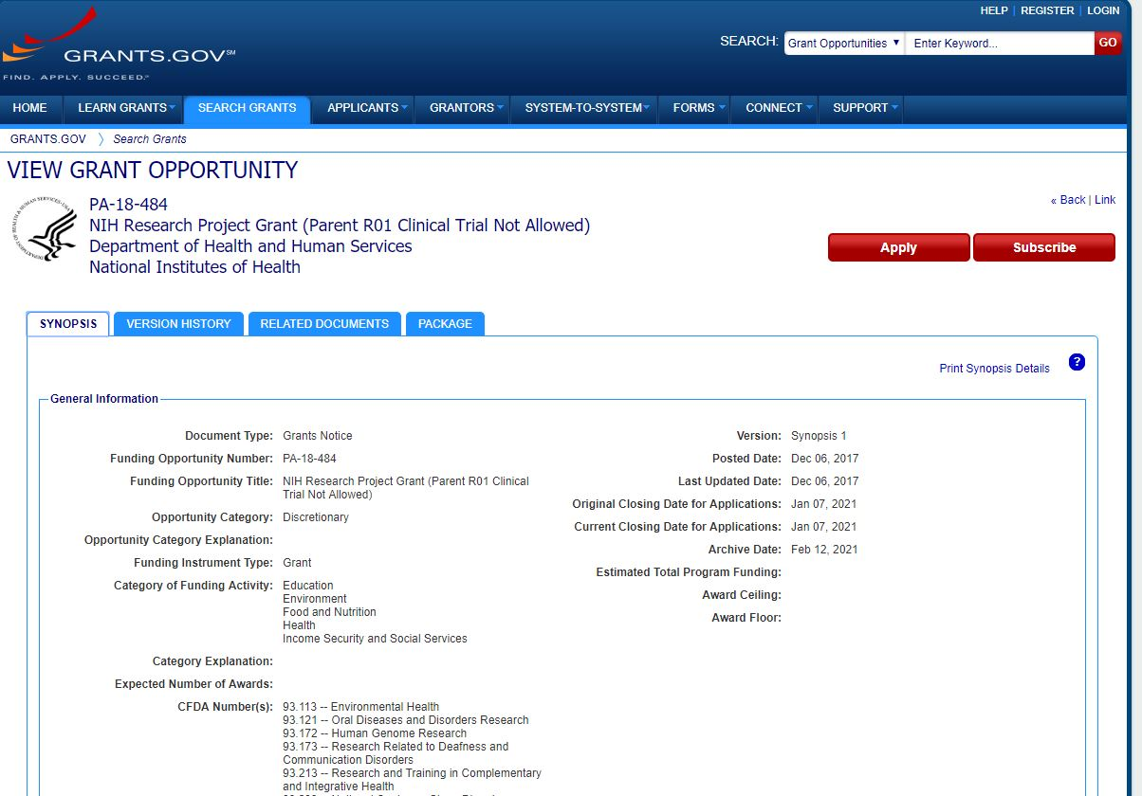
Creating a Workspace (Proposal): 4
Click “Apply”

Slide 14
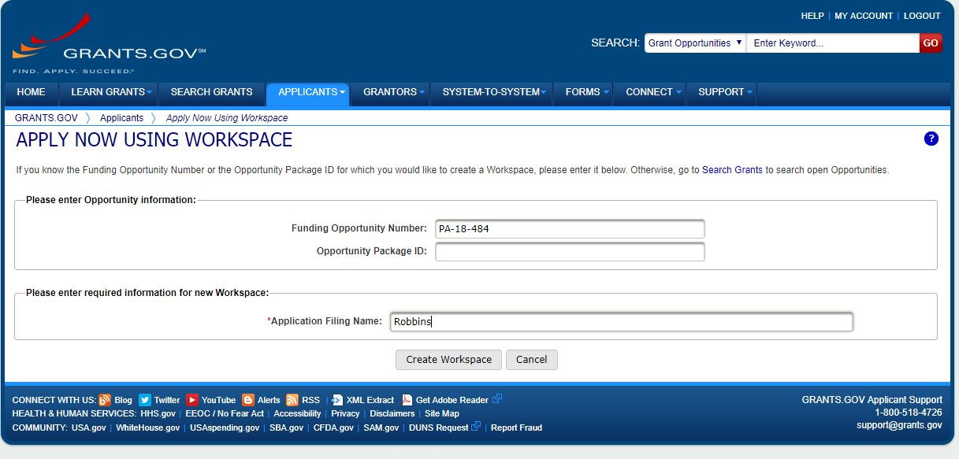
Creating a Workspace (Proposal): 5
Type application filing name and click “Create”

Slide 15
Lesson Learned: Wrong funding announcement downloaded to create the Workspace. Double check it is the correct funding announcement PI wants to apply to before submitting.

Slide 16
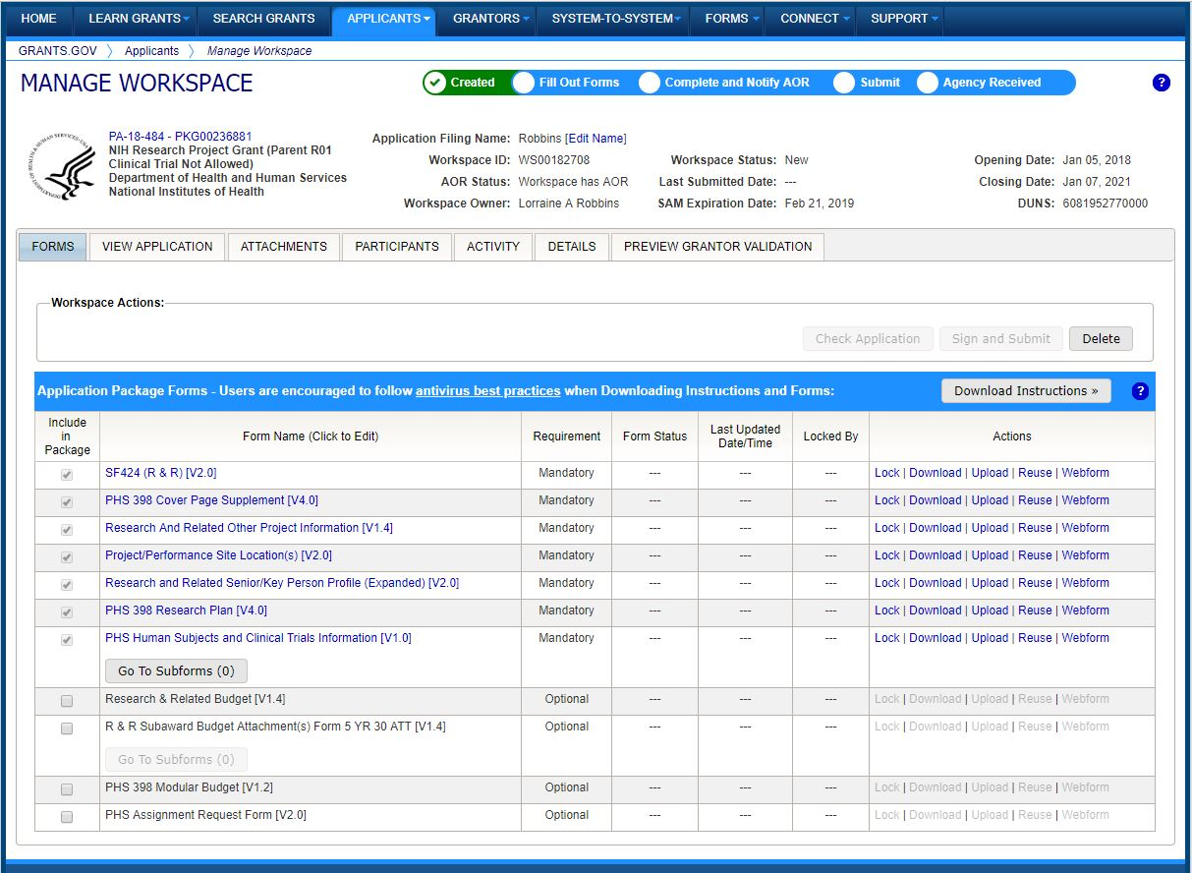
Creating a Workspace (Proposal): 6
New Workspace

Slide 17
Managing a Workspace (Proposal): 1
Two ways to work on forms:
Download and email the form to the Participant. Fill out the form and then upload back to the Workspace when complete.
Complete the forms right from Workspace. Add Participants to the Workspace if multiple people working on the application. Preferred method.
Lesson Learned: Downloading forms to multiple people to complete leaves great room for error. Make sure correct and final version of the form is uploaded.

Slide 18
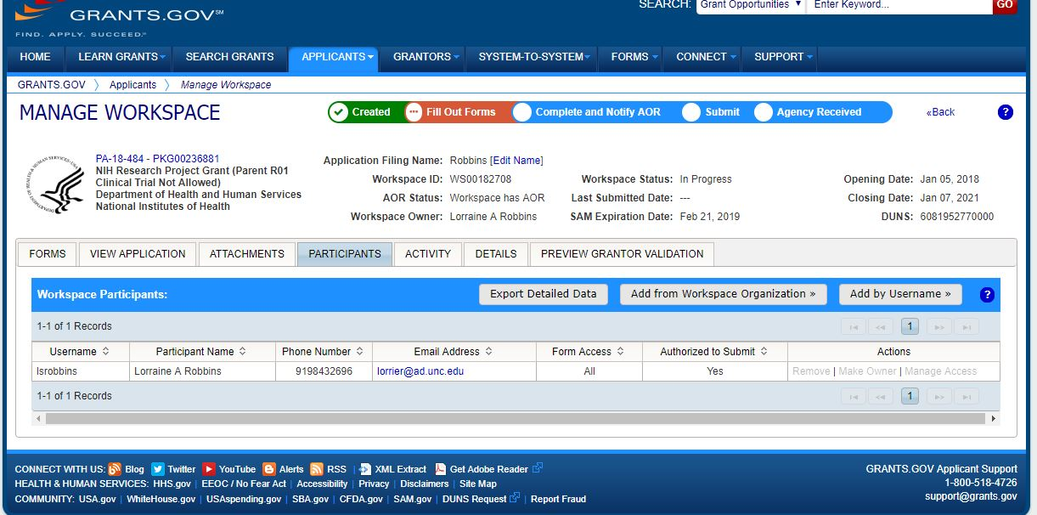
Managing a Workspace (Proposal): 2
Adding a Participant

Slide 19
Managing a Workspace (Proposal): 3
Adding Participants:
Export Detailed Data: Pulls right from Grants.gov profile.
Add from Organization: Pulls from current organization users.
Add by username: useful when adding Participants from another organization.
Lesson Learned: If the Participant profile is not affiliated with UNC then OSR will not be able to view, edit or submit the Workspace.

Slide 20
Managing a Workspace (Proposal): 4
Completing Forms: Mandatory & Optional

Slide 21
Managing a Workspace (Proposal): 5
Completing Forms: Actions

Slide 22
Managing a Workspace (Proposal): 6
Actions:
Lock: locks the form down so no other Participant can use the form while you are using it. Recommended.
Download: downloads the form in the SF424 legacy PDF version.
Upload: Upload a completed downloaded form
Reuse: Can reuse information from a previous Workspace.
Web form: enhanced web version of the form.

Slide 23
Managing a Workspace (Proposal): 7
Completing Forms: individual forms-web form or form name

Slide 24
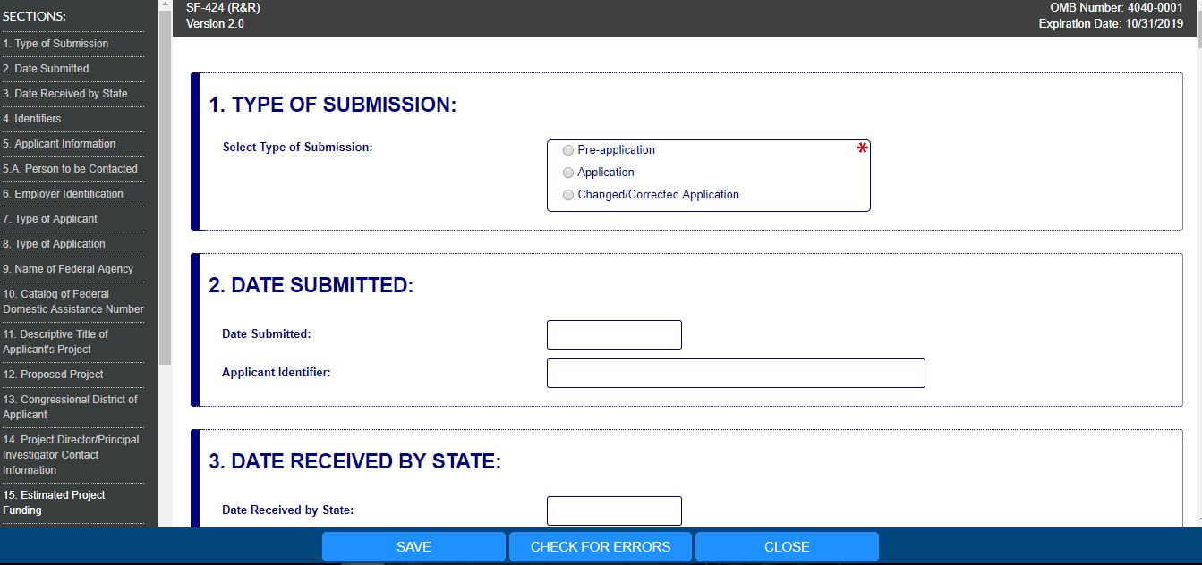
Managing a Workspace (Proposal): 8
Example: SF424 (R&R)

Slide 25
Managing a Workspace (Proposal): 9
Helpful Hints when Completing Forms:
Fields with “*” are required.
Lock the form while working on it.
Keep form locked if you do not want anyone to change your information. Remember to unlock forms prior to submission.
Remember to save your information on the form.
Check for errors before going on to another form.

Slide 26
Managing a Workspace (Proposal): 10
Form Status, Last Updated, Locked By

Slide 27
Managing a Workspace (Proposal): 11
Form Status:
In progress: form is not yet complete and validated
Passed: form is complete, has been validated and ready for submission.
Lesson Learned: All forms should be in the “passed” status to submit. The “check application” and “sign and submit” button will not open unless all forms have passed validation.

Slide 28
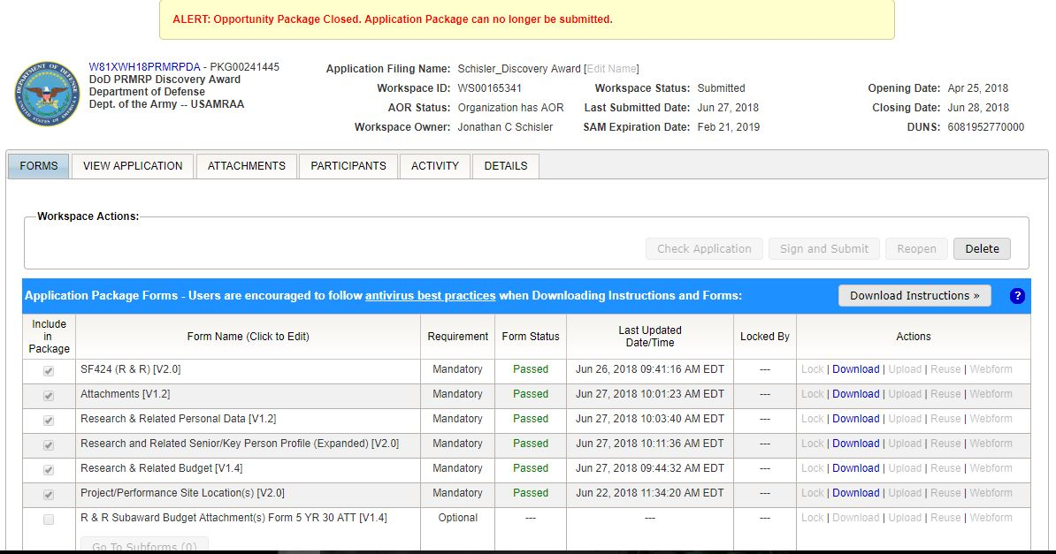
Managing a Workspace (Proposal): 12
Form Status

Slide 29
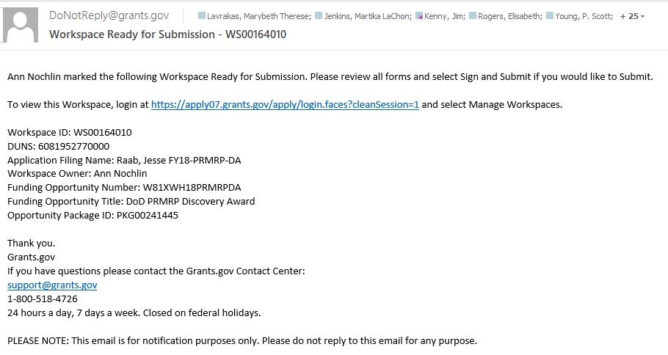
Managing a Workspace (Proposal): 13
PI Ready to Submit and Notifies: email notification

Slide 30
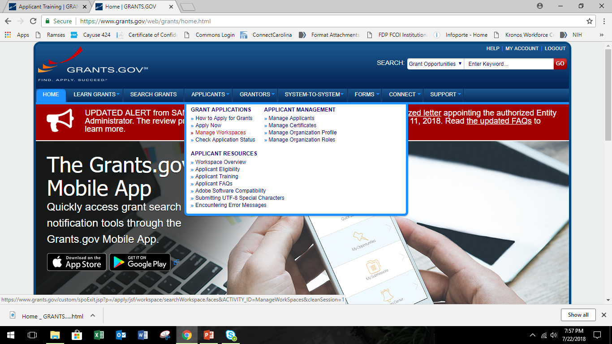
Office of Sponsored Research Role: 1
Managing and Submitting: Manage Workspaces

Slide 31
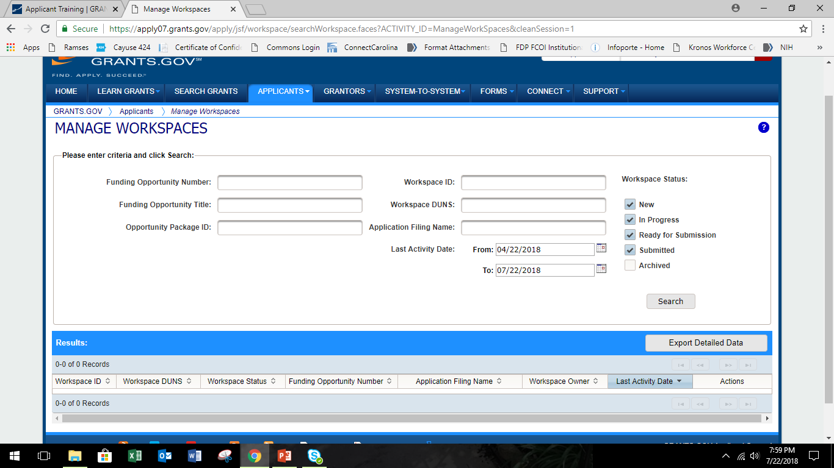
Office of Sponsored Research Role: 2
Managing and Submitting: Search for individual or all for OSR

Slide 32
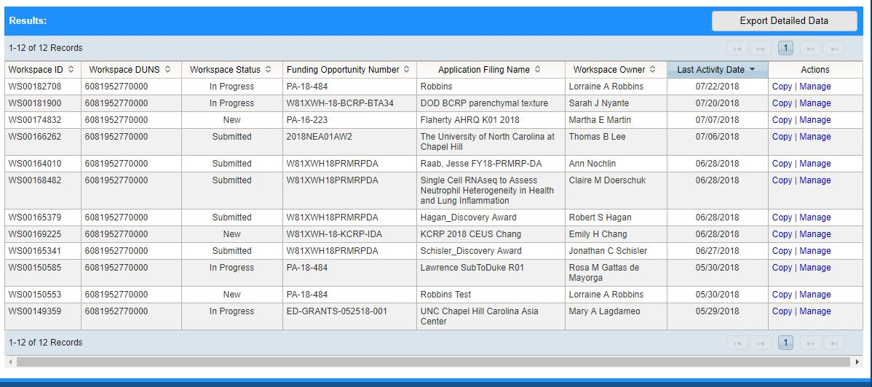
Office of Sponsored Research Role: 3
Managing and Submitting: Click “Search” and “Manage”

Slide 33
Office of Sponsored Research Role: 4
Once all forms passed and application check hit “Sign & Submit”

Slide 34
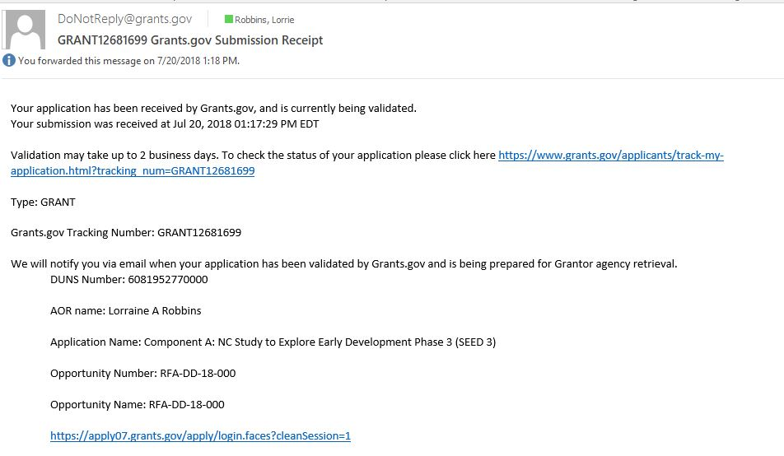
Office of Sponsored Research Role: 5
Emails after Submission: Submission Receipt

Slide 35
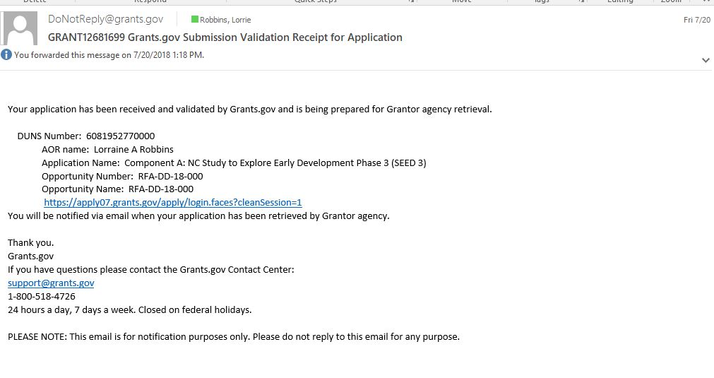
Office of Sponsored Research Role: 6
Emails after Submission: Grants.gov Validation

Slide 36
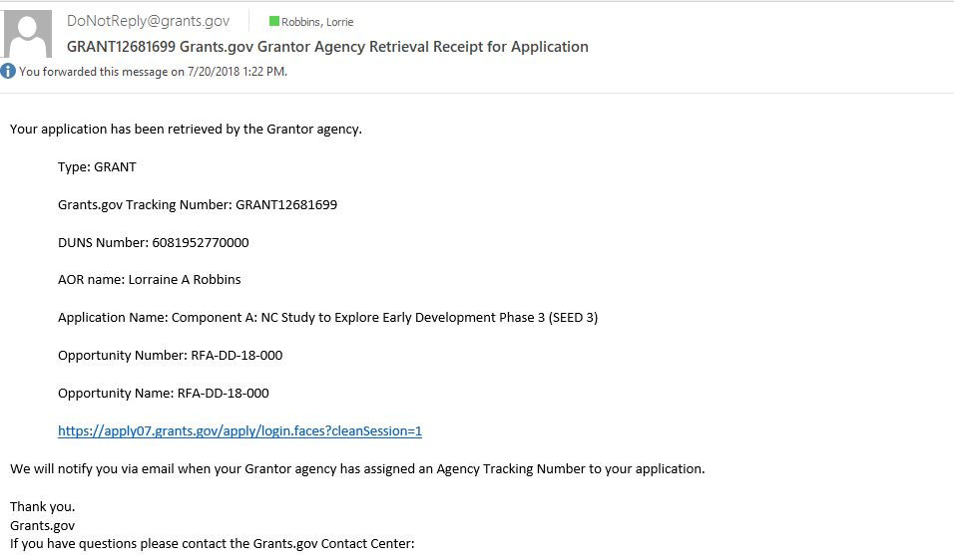
Office of Sponsored Research Role: 7
Emails after Submission: Agency Retrieval

Slide 37
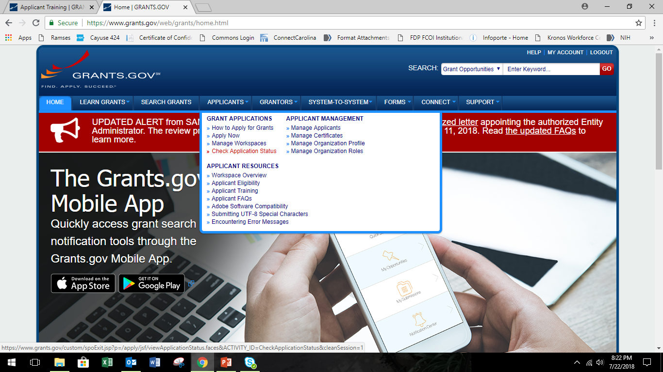
Office of Sponsored Research Role: 8
Application Status

Slide 38
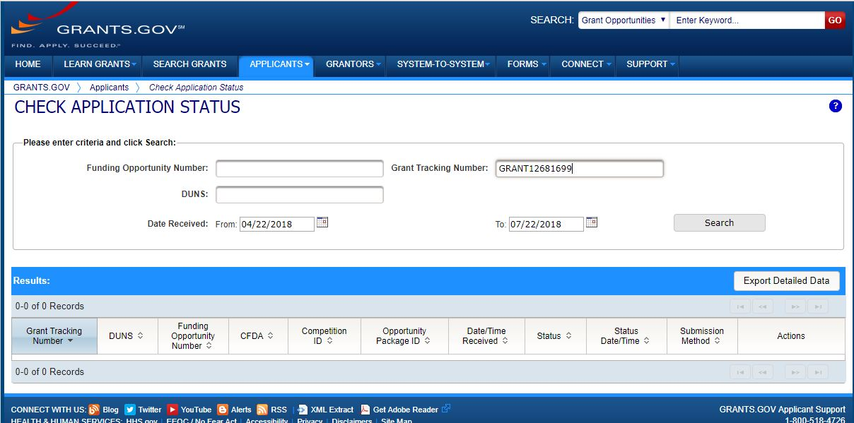
Office of Sponsored Research Role: 9
Application Status

Slide 39
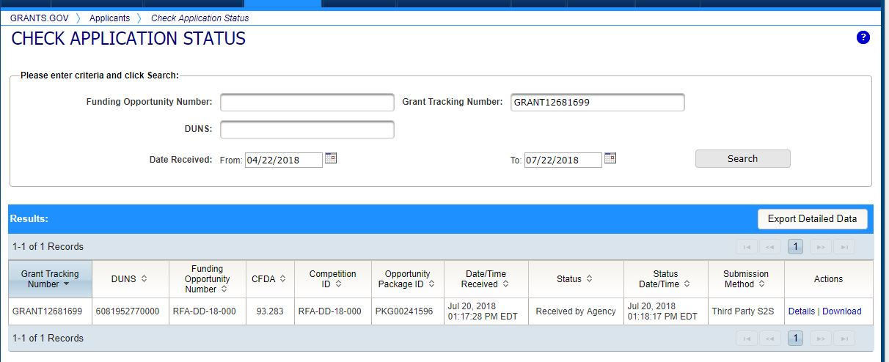
Office of Sponsored Research Role: 10
Application Status

Slide 40
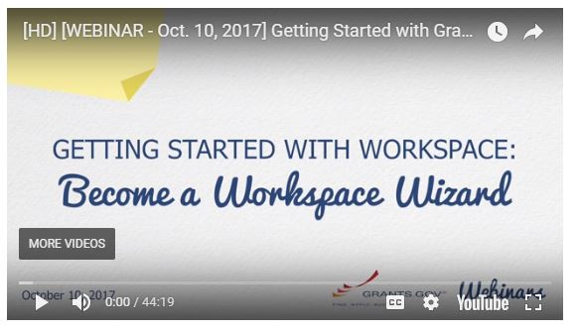
Resources
https://www.grants.gov/web/grants/applicants/applicant-training.html
https://research.unc.edu/files/2018/08/Grants.gov-UNC.ppsx

